Slide 1


23PCCE501L Artificial Intelligence and Machine Learning Laboratory
Group C2_5 :
Team Members:
UCE2023645: Sanjana Nagwani
UCE2023652: Arya Patekhede
UCE2023662: Shruti Sultan

Slide 2

ROAD ACCIDENTS ARE A MAJOR SAFETY CONCERN, ESPECIALLY DURING:
POOR WEATHER
NIGHT TRAVEL
HIGH-SPEED ROUTES
MOST USERS DON’T KNOW THE RISK LEVEL BEFORE CHOOSING A ROUTE.
NAVIGATION APPS ONLY SHOW TRAFFIC, NOT SAFETY RISK.
THERE IS A NEED FOR A SIMPLE TOOL THAT PREDICTS ACCIDENT RISK USING REAL-WORLD FACTORS.

Slide 3


Create a smart system that predicts:
Low / Medium / High Accident Risk for any route
Minimize user input → maximize intelligence
Leverage:
Weather
Road type
Lighting
Time of day
Speed
Driver profile
Provide data-backed safety recommendations
Deliver a clean, responsive web platform

Slide 4
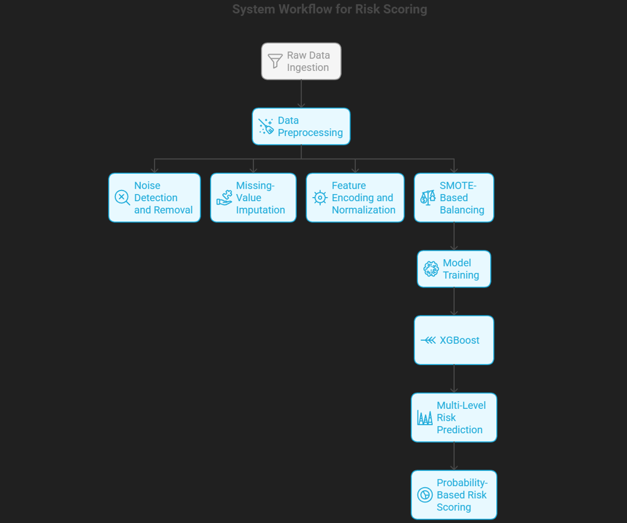
WORK FLOW:
SYSTEM ARCHITECTURE:
Components Used:
Frontend: HTML, CSS
Backend: Flask (Python)
Risk Engine: Rule-based scoring + optional ML model
Processing: User input → Scoring → Prediction
Output: Risk level + recommendation

Slide 5
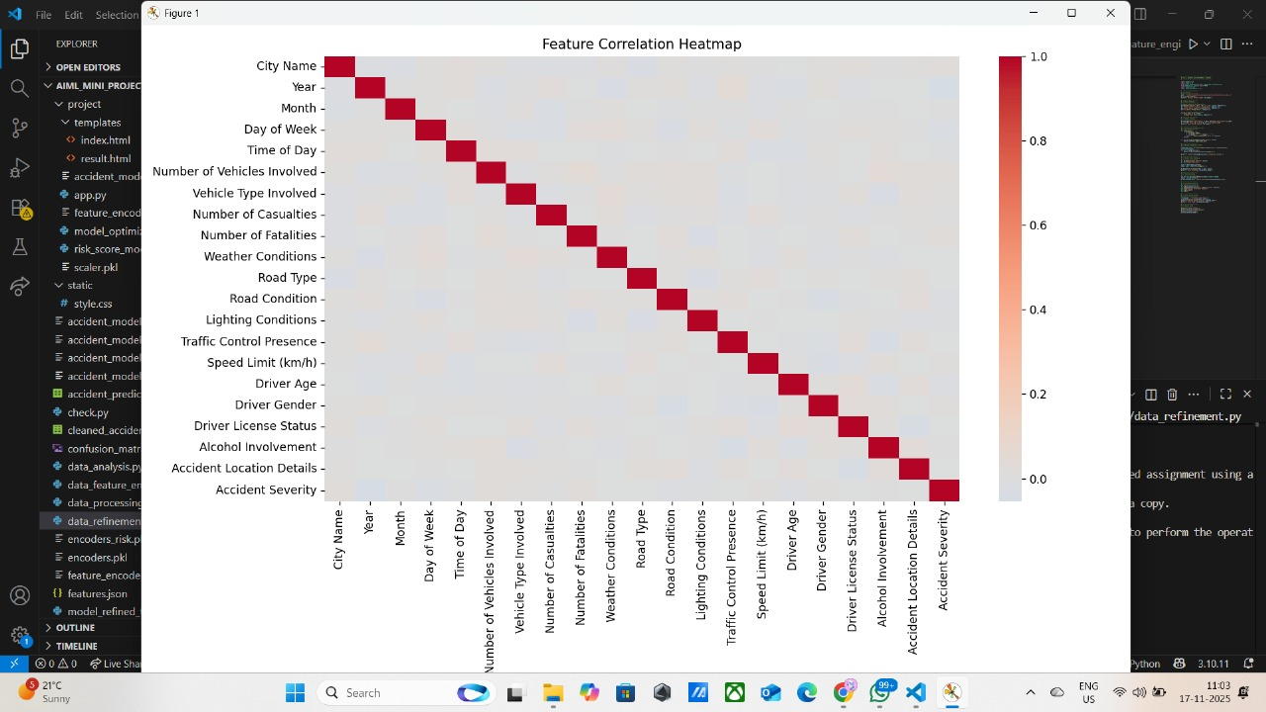
DATASET & FEATURE ENGINEERING:
Dataset Size: 3000 entries
Important Features:
Weather Conditions
Road Type & Lighting
Speed Limit
Driver Age
Day & Time
Accident Severity (Label)
Engineered Features:
Cyclic time encoding (Month_sin,
Month_cos)
Peak hour flag
Weekend flag
Bad weather score
Road risk score

Slide 6


MODEL TRAINING & OPTIMIZATION
Model Used:
Random Forest Classifier + XGBoost
Handles mixed data well
Robust + high accuracy
Training Setup:
80/20 Train–Test Split
Stratified sampling
Class weight = balanced
Tuning
n_estimators: 200
max_depth: 10
min_samples_split: 4

Slide 7
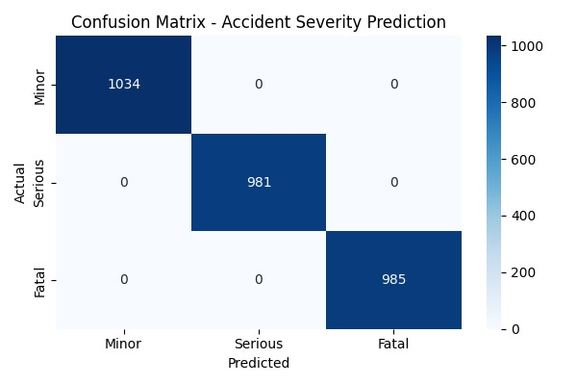
MODEL EVALUATION & RESULTS
Evaluation Metrics:
Accuracy: 87%
F1-Score: Balanced across severity levels
Precision & Recall: Stable for Medium/High-risk classes
Confusion Matrix: Shows improved classification of rare high-risk cases
Key Insights:
Engineered features (Hour_sin/cos, Weather Flag,
Road Risk Score) significantly improved accuracy
Class balancing reduced bias toward low-severity cases
Model performs consistently across different times,
weather, and road types
Outcome
✔ Reliable predictions
✔ Improved identification of high-risk scenarios
✔ Strong generalization to unseen routes

Slide 8
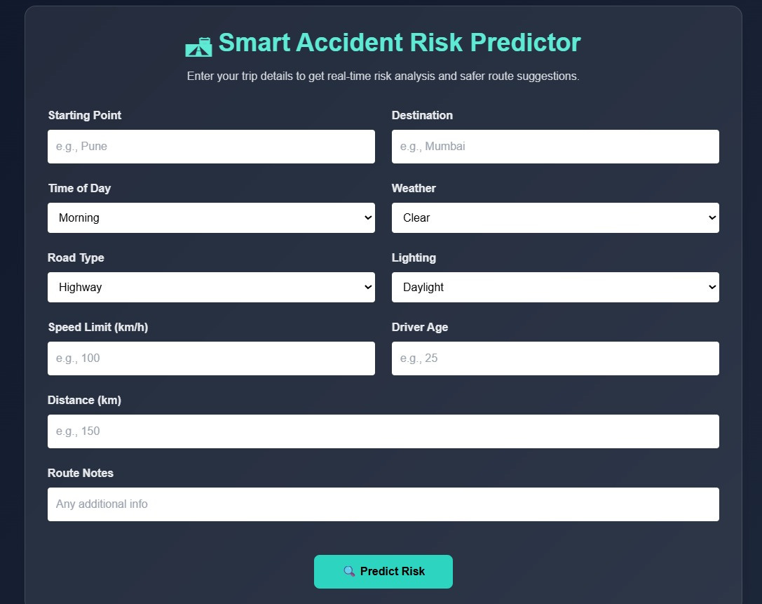
USER INTERFACE
Simple, clean UI with minimal inputs
Auto-filled values remain after submission
Designed for quick and easy safety awareness

Slide 9
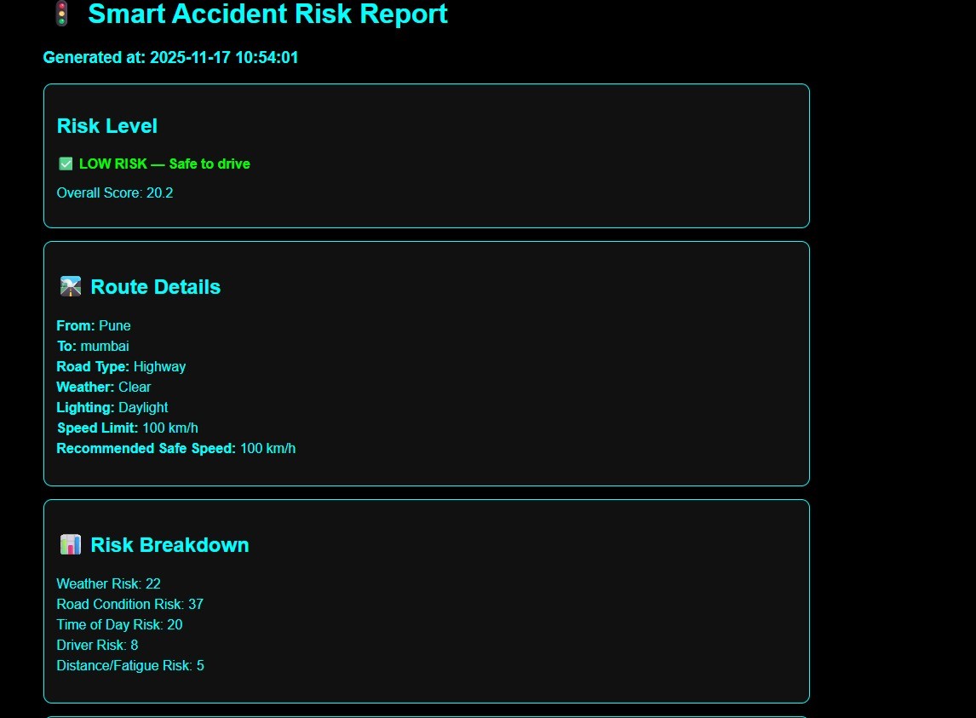
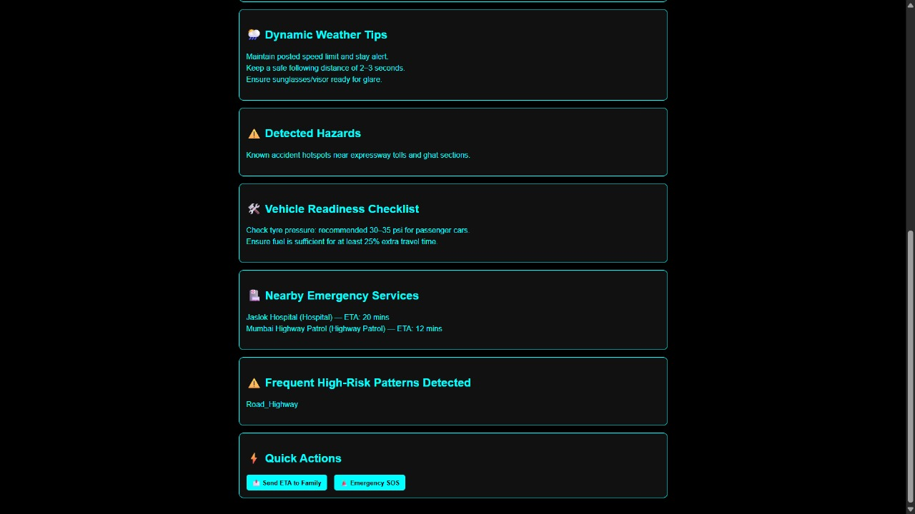
OUTPUT:

Slide 10

CONCLUSION:
Created a functional and user-friendly accident
risk prediction system
Combines rule-based intelligence witH ML DATASET INSIGHTS
HELPS USERS MAKE SAFER TRAVEL DECISIONS
FUTURE SCOPE:
GOOGLE MAPS API INTEGRATION
LIVE WEATHER DATA
REAL-TIME TRAFFIC & ACCIDENT ALERTS
MOBILE APPLICATION
HYBRID ML + SENSOR-BASED PREDICTION

Slide 11


